Slide 1
Module 6: Adding Calculations to a Fact
Analytics: Server Architect (Siebel 7.7)
Notes:
Time: Lecture: approximately 35 minutes; labs: see Lab Guide for timings.
Intent: Discusses how to implement calculation measures into the business model using logical columns, physical columns, and the Calculation Wizard.
Flow: Problem and solution are described, implementation steps for each method are discussed in the context of an ABC example, and guidelines as to when to use each method are discussed.
Key Terms:
Calculation measures
Expression builder
Calculation Wizard
Aggregation rule
6

Slide 2

Module Objectives
After completing this module you will be able to:
  Describe a calculation measure and its use in a business model
  Implement new calculation measures
  Create new calculation measures based on existing logical columns
  Create new calculation measures based on physical columns
  Create new calculation measures using the Calculation Wizard
Why you need to know:
  Calculations allow data to be processed to derive other measurements that are valuable to analysis
Notes:
Each objective and “why you need to know” should be stated aloud.

Slide 3
Business Problem
Businesses need to track the effectiveness of their operations
Businesses want to use business language, not technical speak
  For example: Show me the accounts receivable balance as of Q3
Some information is derived from other data, such as:
  Derive money outstanding
    Compare amount billed with amount received
  Derive units backordered
    Compare units ordered with units shipped
Notes:
Often a business will want to compare values of a measure over time and will need a calculation to express the comparison, as in, for example, a change or percent change. Calculation measures allow end-users to ask business questions like “Show me the accounts receivable balance as of Q3” or “Show me the difference between units ordered and units shipped."
6

Slide 4
Solution
The Siebel Analytics Server provides utilities to create calculation measures in the business model
  Use the Expression Builder utility to create a new logical column with a formula
  Select existing columns as objects in the formula
Notes:
To meet the needs of various business measures, the Siebel Analytics Server has a calculation engine to perform a multitude of calculations. The Expression Builder enables you to create expressions that are similar to expressions created with SQL. In the example in this module, students use the Expression Builder to create a calculation measure that appears as a column to users.

Slide 5
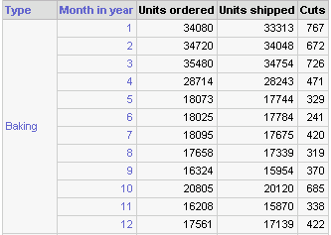
ABC Example
Payment for an order is not due until ABC ships the product
  This delay has a significant effect on ABC’s cash flow
The difference between the units ordered and the units shipped, called Cuts, is an important measure ABC wants to track
Implement a new measure that calculates Cuts
Notes:
This slide presents the ABC example. Cuts, the difference between units ordered and units shipped, is an important business measure that ABC needs to track. Cuts affects customer satisfaction and, potentially, can result in lost revenue. The Cuts calculation measure is modeled in the business model and made available to users as a column in a subject area in Siebel Answers.
6

Slide 6
Implementation Methods
There are three methods for creating calculation measures:
  Use existing logical columns as objects in a formula
  Use physical columns as objects in a formula
  Use the Calculation Wizard to automate the process
    Creates new columns that compare two existing columns
    Uses existing logical columns as objects in a formula
Notes:
This is a structuring slide. All three methods for creating calculation measures are covered in subsequent slides.

Slide 7
Steps for Using Existing Logical Columns
0/3
1. Create a new logical column
2. Specify logical columns as the source
3. Build a formula
Notes:
This is a structuring slide. Do not teach the steps or concepts here because subsequent slides cover them in detail.
6

Slide 8
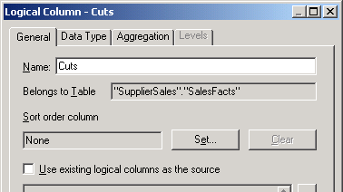
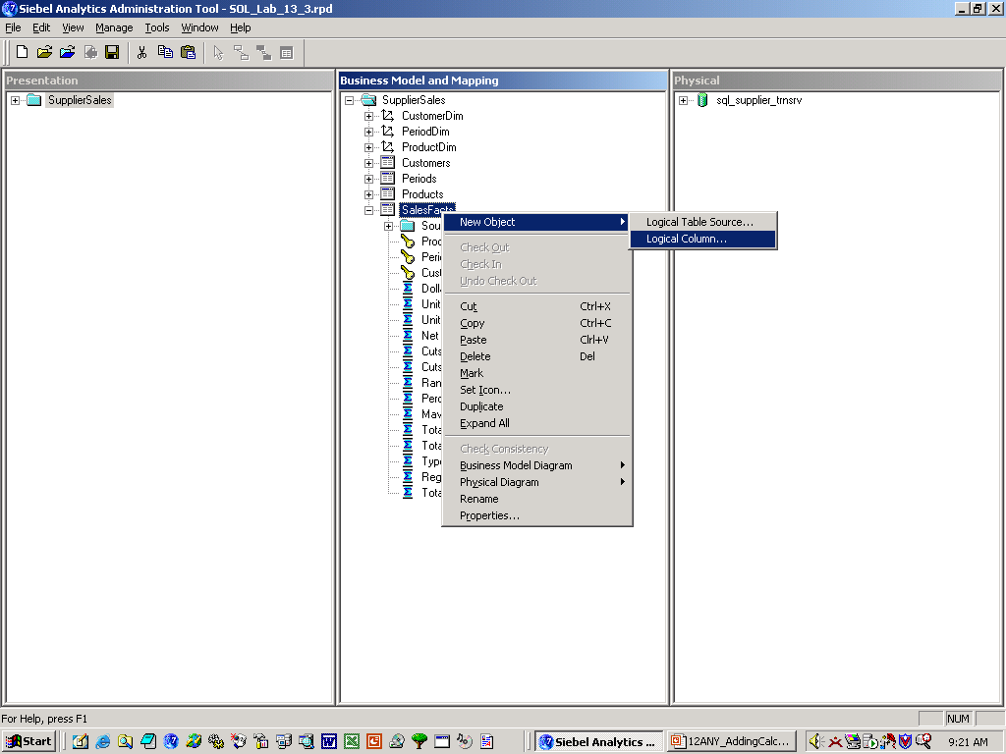
1. Create a New Logical Column
1/3
Right-click the fact table and select New Object > Logical Column
Enter a name for the new column
Notes:
Start by creating a new logical column (Cuts in this example) in the fact table.

Slide 9
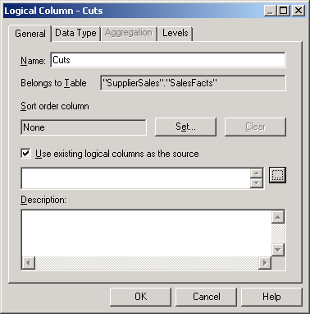
2. Specify Logical Columns as the Source
2/3
Select the Use existing logical columns as the source check box
Notes:
Select the Use existing logical column as the source check box on the General tab of the column properties to specify logical columns as the source for the new Cuts column.
6

Slide 10
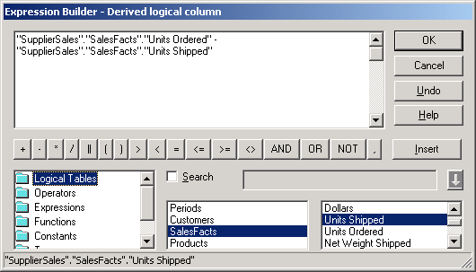
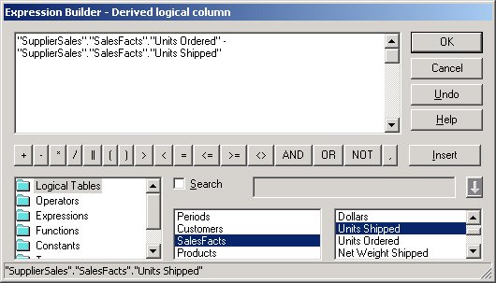
3. Build a Formula
3/3
Open the Expression Builder and build the formula
  Aggregation is applied based on the column aggregation in the formula
Undo deletes the last item inserted into the formula
Select logical columns and click Insert or double-click to build the formula above
Click the Ellipsis button to open the Expression Builder
Notes:
Open the Expression Builder to create the calculation formula (Units Ordered minus Units Shipped) based on existing logical columns. When you are done, Cuts will appear as a new logical column in the fact table.

Slide 11
Steps for Using Physical Columns
0/3
1. Create a new logical column
2. Map the new column
3. Build the formula
Notes:
This is a structuring slide. Do not teach the steps or concepts here because subsequent slides cover them in detail.
6

Slide 12

1. Create a New Logical Column
1/3
Right-click the fact table and select New Object > Logical Column
Specify the aggregation rule
Enter a name for the new column
Notes:
Start by creating a new logical column (CutsP in this example) in the fact table. Verify that the Use existing logical column as the source check box is unselected to specify physical columns as the source for the new CutsP column. Students learn how to specify the aggregation rule in the lab.

Slide 13
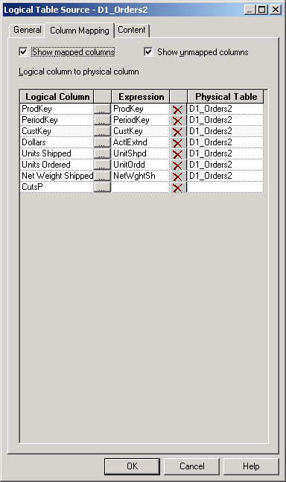
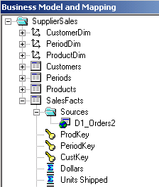
2. Map the New Column
2/3
Open the properties box of the logical table source
Click the Ellipsis button to map the column using the Expression Builder
Select to see unmapped columns
Click to open the Expression Builder
Notes:
To access the Expression Builder, open the properties for the existing logical table source (D1_Orders2 in this example). On the Column Mapping tab, locate the (as yet) unmapped column (CutsP) and click the ellipsis button to open the Expression Builder.
6

Slide 14
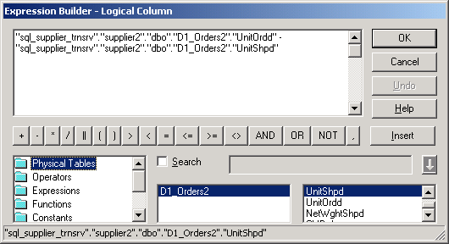
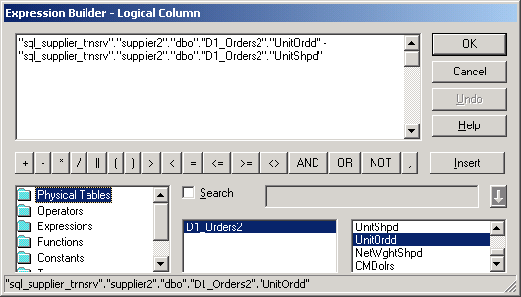
3. Build the Formula
3/3
Select the physical columns to construct the formula
  Building a formula using the physical columns also maps the columns
Select physical columns to build the formula
Notes:
From the Expression Builder, create the calculation formula (Units Ordered minus Units Shipped) based on physical columns. By selecting physical columns as objects in the formula, a column mapping is also configured for the new column. When you are done, CutsP will appear as a new logical column in the fact table.

Slide 15
Steps for Using the Calculation Wizard
0/2
1. Open the Calculation Wizard
2. Follow prompts: select columns and calculations
Notes:
This is a structuring slide. Do not teach the steps or concepts here because subsequent slides cover them in detail.
6

Slide 16
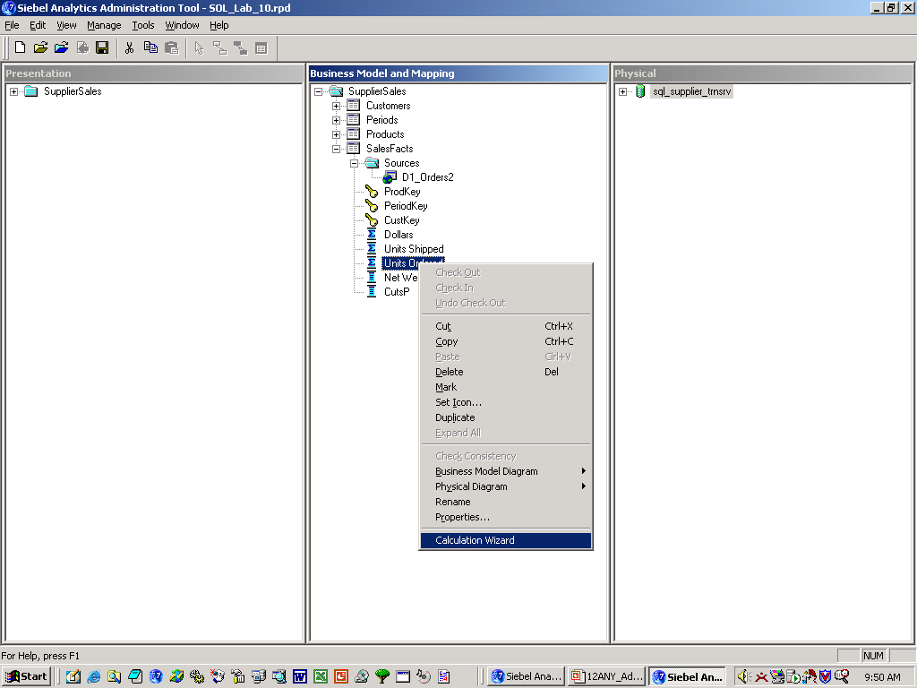
1. Open the Calculation Wizard
1/2
Right-click a logical column you want to use in the calculation and select Calculation Wizard
Notes:
This slide shows how to start the Calculation Wizard. In this example, right-click Units Ordered and select Calculation Wizard to start the wizard.

Slide 17
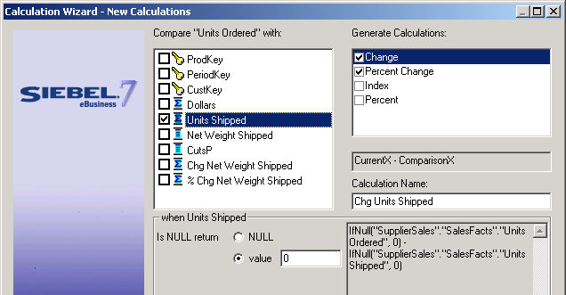
2. Follow Prompts: Select Column and Calculations
2/2
Select the logical column you want to compare and the calculation
Units Shipped is the column to compare with Units Ordered
Change and Percent Changes are the calculations that will be generated by the wizard
Specify the result you want if the column is null
Notes:
The wizard prompts you to select the column you want to compare with Units Ordered (Units Shipped in this example) and the calculations you want to model (Change and Percent Change in this example). The Calculation Wizard can create up to four calculation measures (change, percent change, index, and percent). The wizard also prompts you to specify what value should be returned if the Units Shipped column has no value (is null). This must be specified for the two calculations: Change and Percent Change. Select each in turn and specify what value should be returned. You can enter any numeric value or NULL. Do not enter a value that would change the data type. For example, do not enter NA, which is a character value rather than a numeric value.
6

Slide 18
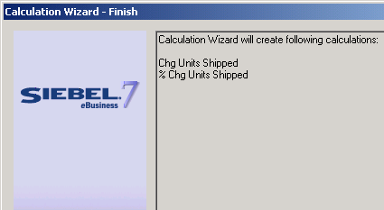
2. Follow Prompts: Creates Comparison Measures
2/2
The Calculation Wizard can create up to four comparison measures (new logical columns) based on existing logical columns
Notes:
The two calculation measures created based on the example in the previous slide appear in the screen capture are added to the fact table as two additional logical columns. The calculation measures are made available to users as columns by dragging each to the presentation catalog in the Presentation layer. They should be renamed so they are more understandable to users. For example, Chg Units Shipped could be renamed to CutsW and % Chg Units Shipped could be renamed to Percent Not Shipped. Students do this in the lab.

Slide 19
Considerations: Using Physical Columns
Use physical columns for calculation formulas that require an aggregation rule (such as sum or average) that is applied after the calculation
select
T79.ItemType as c1,
T9.Month_in_Year as c2,
sum(T55.UnitOrdd - T55.UnitShpd) as c3
from
D1_Calendar2 T9,
D1_product_subtypes T75,
D1_product_type T79,
D1_products T82,
D1_Orders2 T55
where
T9.YYYYMMDD = T55.PeriodKey and
T75.TypeCode = T79.TypeCode and
T75.SubtypeCode = T82.SubtypeCode and
T55.ProdKey = T82.ProductKey and
1999 = T9.Year
group by
T9.Month_in_Year,
T79.ItemType
Using physical columns, the SQL:
Calculates the difference between units ordered and units shipped
Applies aggregation rules
Notes:
This slide and a following slide address when it is best to use logical columns versus physical columns as objects in a calculation formula.
This is easily determined by knowing when an aggregation rule is applied in the calculation.
Use logical columns when the aggregation rule is applied before the calculation.
Use physical columns when the aggregation rule is applied after the calculation.
In our example, CutsP is based on physical columns. We can see in the SQL that the aggregation rule, in this case sum, is applied after the calculation; this is expressed as sum(UnitOrd – UnitShpd).
The next slide examines another example of when to configure a calculation measure based on physical columns.
6

Slide 20
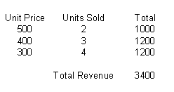
Example: Using Physical Columns
Example: To accurately calculate total revenue, you would multiply the unit price by the number of units sold, and then sum the totals
Notes:
In this example the calculation measure, total revenue, is based on physical columns; the aggregation rule is applied after the calculation.
Total revenue is derived by calculating, row-by-row, the unit price times units sold and then applying the sum aggregation rule after the calculation to find total revenue.
What would happen if the aggregation rule was applied before the calculation? Said another way, what would happen if the calculation measure, total revenue, was based on logical columns?
Applying the summation (aggregation rule) before the calculation looks like this:
unit price $500 + $400 + $300 = $1,200
units sold 2 + 3 + 4 = 9
The calculation would then look like this:
$1,200 x 9 = $10,800
As you can see, this calculation is not correct. Applying the aggregation rule (summing the unit price and the units sold) before the calculation (unit price * units ordered) does not accurately calculate total revenue.

Slide 21
Considerations: Using Logical Columns
Use logical columns for calculation formulas that require an aggregation rule that is applied before the calculation
select distinct d1.c3 as c1,
  d1.c4 as c2,
  d1.c1 as c3,
  d1.c2 as c4,
  d1.c2 - d1.c1 as c5
from
  (select sum(T55.UnitShpd) as c1,
  sum(T55.UnitOrdd) as c2,
  T79.ItemType as c3,
  T9.Month_in_Year as c4
  from
    D1_Calendar2 T9,
    d1_product_subtypes T75,
    D1_product_type T79,
    D1_products T82,
    D1_Orders2 T55
where
T75.TypeCode = T79.TypeCode and
T9.YYYYMMDD = T55.PeriodKey and
T75.SubtypeCode = T82.SubtypeCode and
T9.Year = 1999 and T55.ProdKey = T82.ProductKey
group by
T9.Month_in_Year,
T79.ItemType
Using logical columns, the SQL applies the aggregation rule (sum) to the units shipped and the units ordered first …
… and then calculates the difference
Notes:
In our example, Cuts is based on logical columns. In the SQL code on this slide, we see that a sub-query applies the aggregation rule before the calculation. The next slide examines another example of when to configure a calculation measure based on logical columns.
6

Slide 22
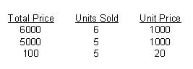
Example: Using Logical Columns
To accurately calculate a unit price, you would total the dollars sold and divide by the total of the units sold
Notes:
In this example, the calculation measure, unit price, is based on logical columns; therefore, the aggregation rule is applied before the calculation. Unit price is found by applying the aggregation rule (summing the total price) before calculating the unit price (dividing total price by units sold).

Slide 23
Considerations: Calculation Wizard
Use the wizard for more involved calculations
  Uses existing logical columns—use for calculation formulas that require an aggregation rule that is applied before the calculation
Notes:
When using the Calculation Wizard to model calculation measures, it is important to consider that the wizard uses logical columns as objects in the calculation formulation; therefore, an aggregation rule is applied before the calculation.
6

Slide 24
Summary
This module showed you how to:
  Describe a calculation measure and its use in a business model
  Implement new calculation measures
  Create new calculation measures based on existing logical columns
  Create new calculation measures based on physical columns
  Create new calculation measures using the Calculation Wizard
Notes:
Review Questions:
Question: Why are calculation measures important to a business?
Answer: Calculation measures enable businesses to track the effectiveness of their operations.
Question: What utility in the Analytics Administration Tool enables you to model a calculation measure using existing columns as objects in a formula?
Answer: The Expression Builder utility
Question: When should you use physical columns for calculation formulas?
Answer: Use physical columns when an aggregation rule is applied after the calculation.
Question: When should you use logical columns for calculation formulas?
Answer: Use logical columns when an aggregation rule is applied before the calculation.

Slide 25
Lab
In the lab you will:
  Create new calculation measures
Notes:
Labs and Troubleshooting:
See Lab Guide for details.
6

